Slide 1
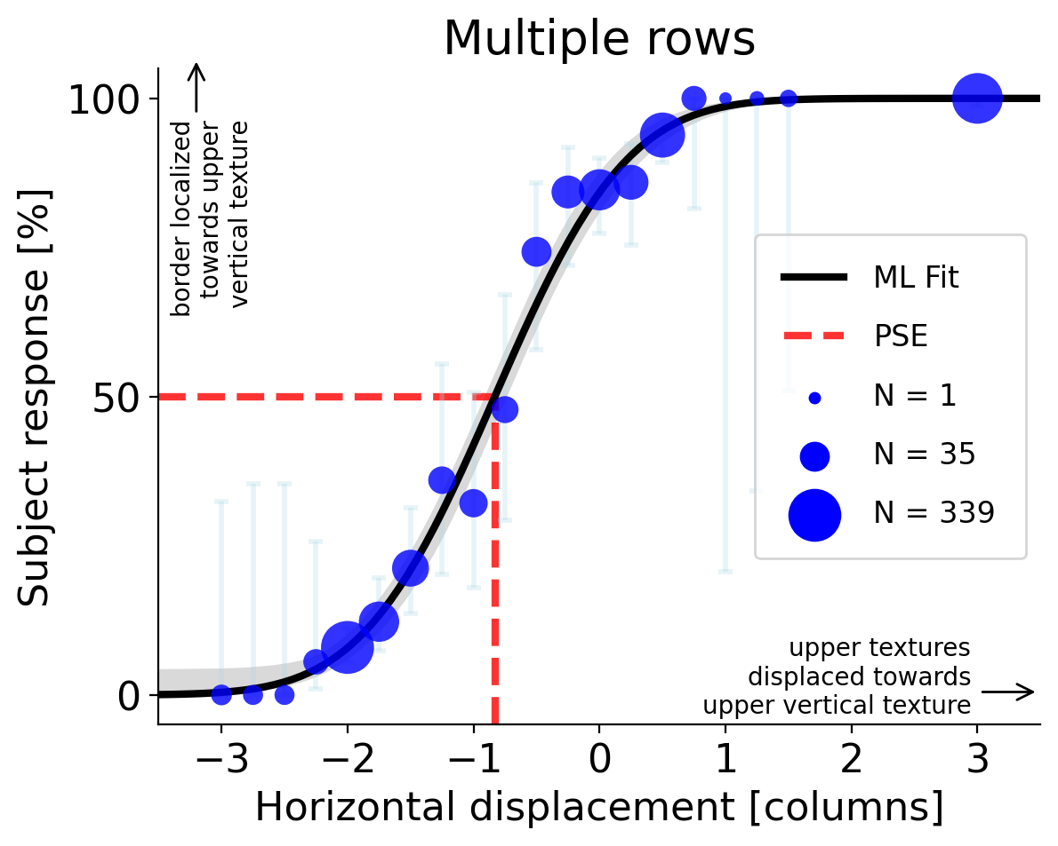
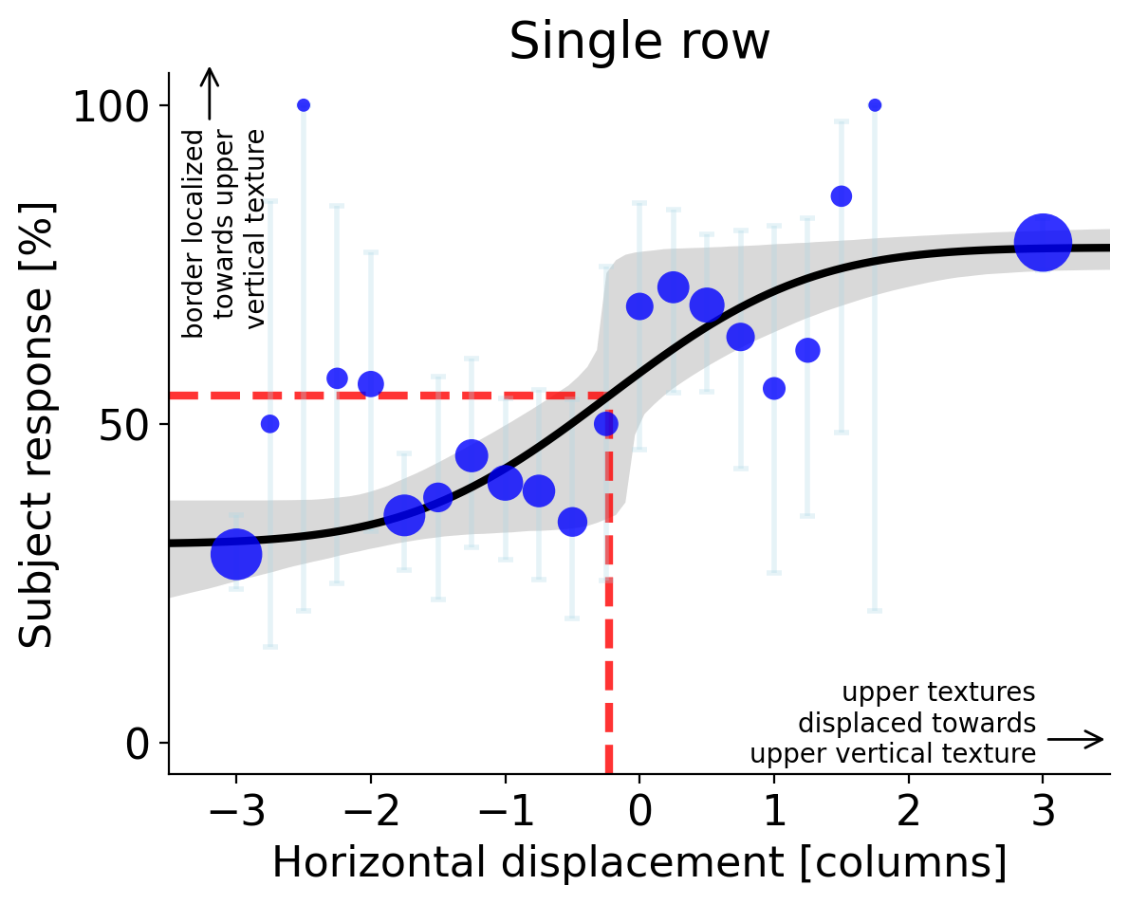
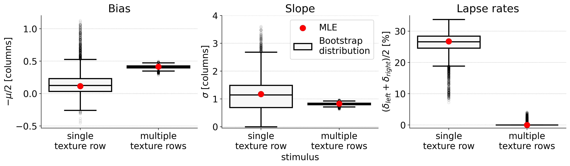



A
B
C
D
E
$$p_{0}≈3⋅{10}^{−4}$$
$$p_{0}≈0.22$$
$$p_{0}<{10}^{−5}$$

